Slide 1

Diode Circuit Problems & Logic Gates
Lecture 9
Course No: CSE 251
Course Title: Electronic Devices and Circuits
Partial Credit:
Aroni Ghosh (AGS)
Lecturer(On Leave), CSE, Brac University

Slide 2
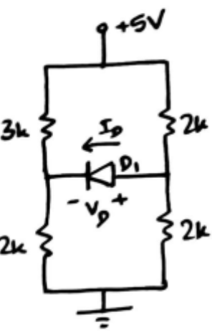
Problem 2(Use CVD model)

Slide 3
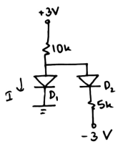
Problem 3(Use Ideal model)

Slide 4
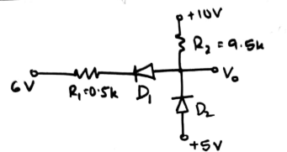
Problem 4(CVD model)
Ans: V_{o}=6.865 V

Slide 5
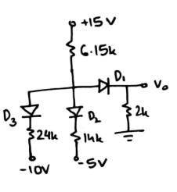
Problem 5(CVD model)
Ans: V_{o}=2V

Slide 6
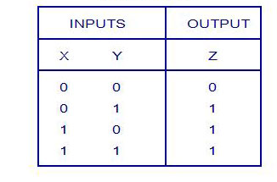
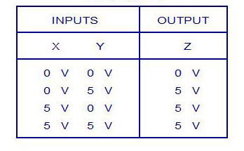
Logical Operations with Diode (OR)
Logic Truth Table
Voltage Truth Table
Low/False High/True
Logic Levels: 0 1
Corresponding voltage levels: 0V 5V

Slide 7
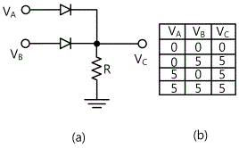
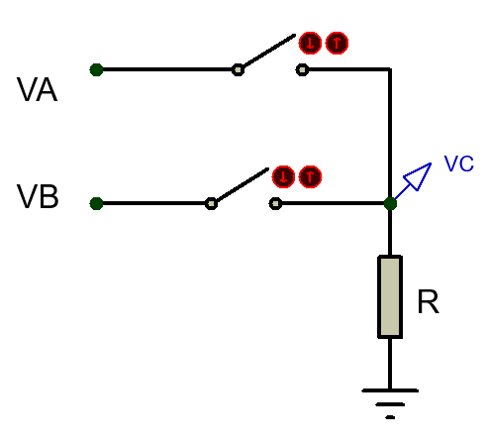
Logical Operations with Diode (OR)
D1
Case 1: V_{A}= 0V, V_{B}= 0V
Both D1 and D2 are off as V_{anode}<V_{cathode}
Replace D1 and D2 with open circuits.
So, V_{C}= 0V
D2
R is a Pull Down Resistor which pulls down the voltage of V_{C} from floating condition to 0V.

Slide 8
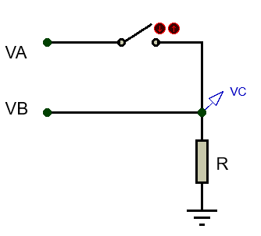
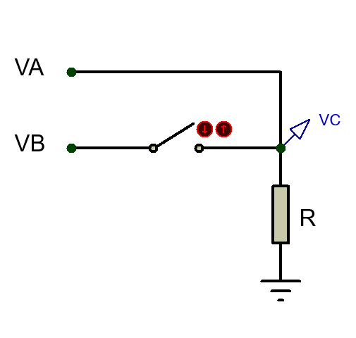
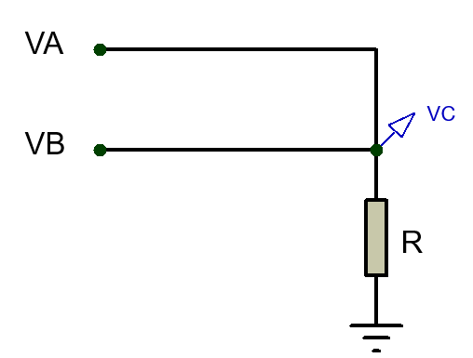
Logical Operations with Diode (OR)
Case 2: V_{A}= 0V, V_{B}= 5V
D1 is off and D2 is on
Replace D1 with open circuit and D2 with short circuit.
So, V_{C}= V_{B}= 5V
Case 3: V_{A}= 5V, V_{B}= 0V
D1 is on and D2 is off
Replace D1 with short circuit and D2 with open circuit.
So, V_{C}= V_{A}= 5V
Case 1: V_{A}= 5V, V_{B}= 5V
Both D1 and D2 are on
Replace D1 and D2 with short circuits.
So, V_{C}= V_{A}= V_{B}= 5V

Slide 9
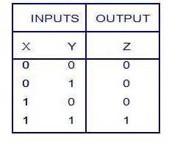
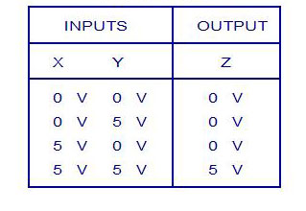
Logical Operations with Diode (AND)
Logic Truth Table
Voltage Truth Table

Slide 10
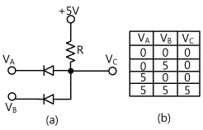
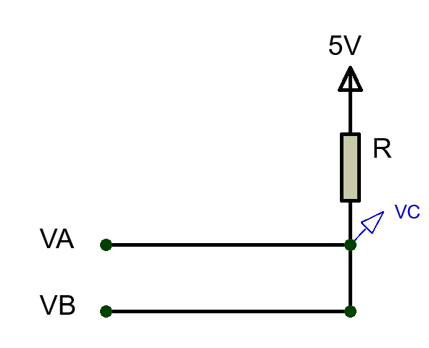
Logical Operations with Diode (AND)
Case 1: V_{A}= 0V, V_{B}= 0V
Both D1 and D2 are on as V_{anode}>V_{cathode}
Replace D1 and D2 with short circuits.
So, , V_{C}= V_{A}= V_{B}= 0V
D1
D2
R is a Pull Up Resistor which pulls up the voltage of V_{C} from floating condition to 5V.

Slide 11
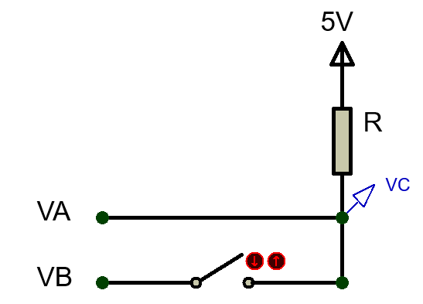
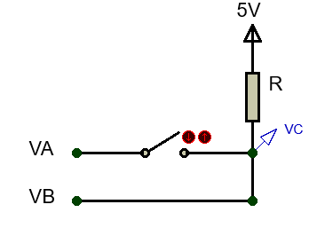
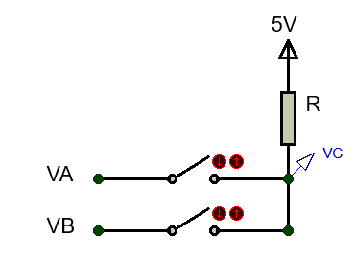
Logical Operations with Diode (AND)
Case 2: V_{A}= 0V, V_{B}= 5V
D1 is on and D2 is off
Replace D1 with short circuit and D2 with open circuit.
So, V_{C}= V_{A}= 0V
Case 3: V_{A}= 5V, V_{B}= 0V
D1 is off and D2 is on
Replace D1 with open circuit and D2 with short circuit.
So, V_{C}= V_{B}= 0V
Case 1: V_{A}= 5V, V_{B}= 5V
Both D1 and D2 are off
Replace D1 and D2 with open circuits.
So, V_{C}= 5V

Slide 12
Effect of input Voltage Variation in Logic Gates (OR)
D1
Case 1: Assuming both D1 and D2 are on
Replace D1 and D2 with short circuits.
So, V_{C} is short with both V_{A} and V_{B}
Can V_{C} be 4V and 5V at the same time???
So this assumption is wrong!
D2
If V_{A}= 4V and V_{B}= 5V, what is the value of output V_{C}?

Slide 13
Effect of input Voltage Variation in Logic Gates (OR)
Case 2: Assuming both D1 and D2 are off
Replace D1 and D2 with open circuits. So, V_{C}= 0V
But now V_{anode}(4V for D1, 5V for D2)>V_{cathode}(0V) for both diode
So this assumption is also wrong!
Case 3: Assuming D1 is on and D2 is off
Replace D1 with short circuit and D2 with open circuit. So, V_{C}= V_{A}= 4V
But now for D2, V_{anode}(5V)>V_{cathode}(4V). So, D1 should have been ON!
So this assumption is also wrong!
Case 4: Assuming D1 is off and D2 is on
Replace D1 with open circuit and D2 with short circuit. So, V_{C}= V_{B}= 5V
Now for D1, V_{anode}(4V)<V_{cathode}(5V). So, D1 should be OFF!
So this assumption is correct!

Slide 14
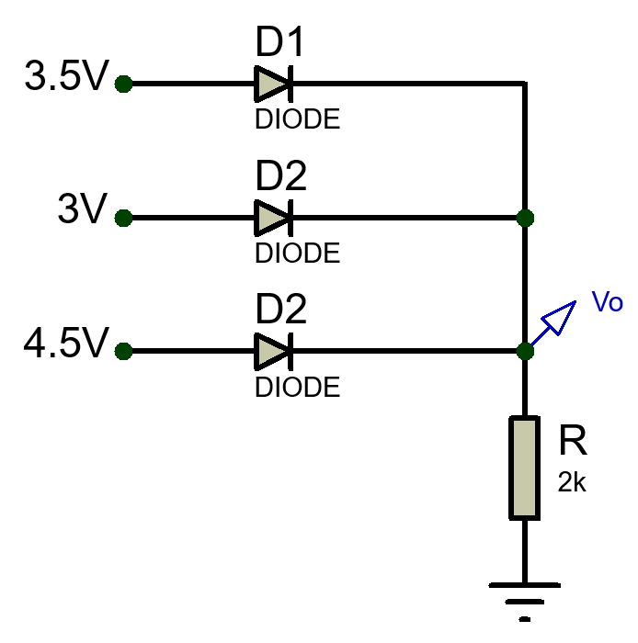
Effect of input Voltage Variation in Logic Gates (OR)
Example 4: Find the value of Vo
D1 and D2 are OFF → Open Circuit
Only D3 is ON → Short Circuit
Vo= 4.5V
Current, I= 4.5V/2kΩ= 2.25 mA

Slide 15
Effect of input Voltage Variation in Logic Gates (AND)
Case 1: Assuming both D1 and D2 are on
Replace D1 and D2 with short circuits.
So, V_{C} is short with both V_{A} and V_{B}
Can V_{C} be 1V and 2V at the same time???
So this assumption is wrong!
If V_{A}= 1V and V_{B}= 2V, what is the value of output V_{C}?

Slide 16
Effect of input Voltage Variation in Logic Gates (AND)
Case 2: Assuming both D1 and D2 are off
Replace D1 and D2 with open circuits. So, V_{C}= 5V
But now V_{anode}(5V)>V_{cathode}(1V for D1 & 2V for D2) for both diode
So this assumption is also wrong!
Case 3: Assuming D1 is off and D2 is on
Replace D1 with open circuit and D2 with short circuit. So, V_{C}= V_{B}= 2V
But now for D1, V_{anode}(2V)>V_{cathode}(1V). So, D1 should have been ON!
So this assumption is also wrong!
Case 4: Assuming D1 is on and D2 is off
Replace D1 with short circuit and D2 with open circuit. So, V_{C}= V_{A}= 1V
Now for D2, V_{anode}(1V)<V_{cathode}(2V). So, D2 should be OFF!
So this assumption is correct!

Slide 17
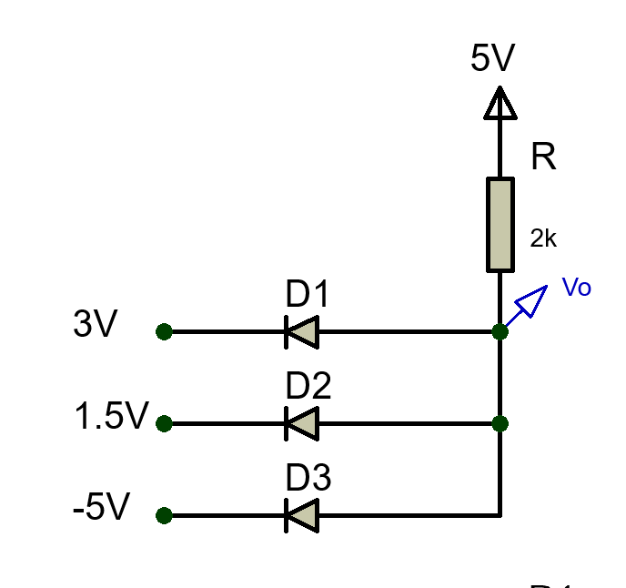
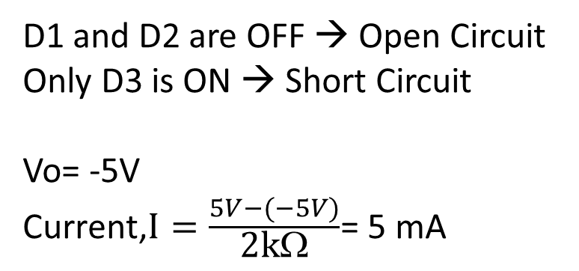
Effect of input Voltage Variation in Logic Gates (AND)
Example 5: Find the value of Vo
D1 and D2 are OFF → Open Circuit
Only D3 is ON → Short Circuit
Vo= -5V
$\text{Current}\text{,}I=\frac{5V−(−5V)}{\text{2}\text{k}\text{Ω}}$= 5 mA

Slide 18
Thank You

